Slide 1
Android Testing Framework
Espresso
Kai Yu

Slide 2
Overview
Android testing framework (pros and cons)
Espresso
How to set up
How to use
Demo
Conclusion
Q&A

Slide 3
Overview
Android testing framework (pros and cons)
Espresso
How to set up
How to use
Demo
Conclusion
Q&A

Slide 4
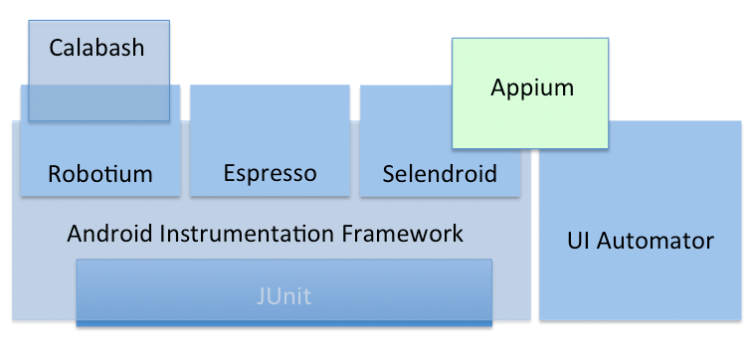
Android testing framework
Reference:
http://www.infologs.org/2015/01/14/the-basics-of-test-automation-for-apps-games-and-the-mobile-web/
http://www.slideshare.net/bitbar/different-android-test-automation-framework-what-works-you-the-best
Notes:
Espresso is a thin layer on top of android instrumentation framework.
I’ll focus on Espresso and UI Automator, and list their pros and cons.

Slide 5
JUnit
JUnit is a unit testing framework for the Java programming language. JUnit has been important in the development of test-driven development.
The Android testing API is based on the JUnit API and extended with a instrumentation framework and Android-specific testing classes.
Reference:
https://en.wikipedia.org/wiki/JUnit
http://developer.android.com/tools/testing/testing_android.html
Notes:
Everything is almost based on this.

Slide 6
Android Instrumentation Framework
Android instrumentation is a set of control methods, and you can control an Android component independently of its normal life cycle (also control how Android loads applications).
Notes:
You can control Android components’ life cycle.

Slide 7
Robotium
Pros:
Easy to write, shorter code
Powerful and robust automatic black-box test
Can be used both for testing application with/without source code
Support all API levels
Cons:
Can not simulate clicking on softkeyboard
It is not possible to handle multiple processes at a time
Can not interact with status bar notifications
Can be a bit slow, especially running on older devices
Reference:
http://robotiumsolo.blogspot.tw/2012/12/what-is-robotium.html
http://www.infologs.org/2015/01/14/the-basics-of-test-automation-for-apps-games-and-the-mobile-web/
Notes:
The oldest and widely use

Slide 8
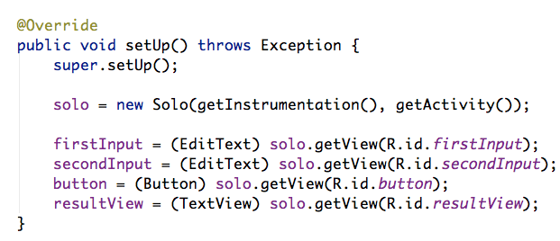
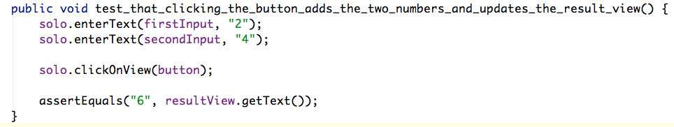
Robotium (cont.)
Source code example:

Slide 9
Calabash
Pros:
Cross-platform
Easy-to-understand syntax
Support all API levels
Cons:
“Debugging” of tests is not possible
Reference:
http://blogmobile.itude.com/2013/11/26/functional-testing-for-android/
http://developer.xamarin.com/guides/testcloud/calabash/introduction-to-calabash/
Notes:
Like a toy.

Slide 10
Calabash (cont.)
Source code example
Feature: Credit card validation. Credit card numbers must be exactly 16 characters. Scenario: Credit card number is too short Given I use the native keyboard to enter "123456" into text field number 1 And I touch the "Validate" button Then I see the text "Credit card number is too short." Scenario: Credit card number is too long Given I try to validate a credit card number that is 17 characters long Then I should see the error message "Credit card number is too long."

Slide 11
Appium
Pros:
Cross-platform
Supports almost any programming languages
Allow you to communicate with other applications
Support all API levels
Cons:
No support for intelligent waits
Limited support for gestures
Limited support for Android < 4.1
Reference:
https://blog.codecentric.de/en/2014/05/android-ui-testing-appium/
http://www.fredberinger.com/2013/12/4-reasons-why-appium-is-not-ready-for-prime-time/
Notes:
Appium uses UIAutomator for Android automation

Slide 12
Appium (cont.)
@Test public void appiumExampleTest() throws Exception { // find button with label or content-description "Button 1" WebElement button=driver.findElement(By.name("Button 1")); // click on button and start second Activity button.click(); // we are on second screen now // check if second screen contains TextView with text “Activity2” driver.findElement("Activity2"); // click back button HashMap<String, Integer> keycode = new HashMap<String, Integer>(); keycode.put("keycode", 4); ((JavascriptExecutor) driver).executeScript("mobile: keyevent", keycode); // we are again in main activity driver.findElement(By.name("Button1")); } @After public void tearDown() { if (driver != null) { driver.quit(); } } }
Source code example
public class AppiumExampleTest { private WebDriver driver = null; @Before public void setup() { File appDir = new File("..//TestedAndroidApp//bin//"); File app = new File(appDir, "TestedAndroidApp.apk"); DesiredCapabilities capabilities = new DesiredCapabilities(); capabilities.setCapability(CapabilityType.BROWSER_NAME, ""); capabilities.setCapability(CapabilityType.VERSION, "4.2"); capabilities.setCapability(CapabilityType.PLATFORM, "WINDOWS"); capabilities.setCapability(CapabilityConstants.DEVICE, "android"); capabilities.setCapability(CapabilityConstants.APP_PACKAGE, "com.example.android"); capabilities.setCapability(CapabilityConstants.APP_ACTIVITY, "MainActivity"); capabilities.setCapability(CapabilityConstants.APP, app.getAbsolutePath()); try { driver = new RemoteWebDriver(new URL("http://127.0.0.1:4723/wd/hub"), capabilities); } catch (MalformedURLException e) { e.printStackTrace(); } driver.manage().timeouts().implicitlyWait(80, TimeUnit.SECONDS); }

Slide 13
UI Automator
Pros:
Developed by Google
Provides 5 different useful classes
Over entire OS
Cons:
Only supports API level 16 and above
No support for web views (or very limited)
Reference:
http://kratinmobile.com/blog/index.php/ui-automator-review/
http://blogmobile.itude.com/2013/11/26/functional-testing-for-android/

Slide 14
UI Automator (cont.)
@Test
public void checkPreconditions() {
assertThat(mDevice, notNullValue());
}
@Test
public void testChangeText_sameActivity() {
// Type text and then press the button.
mDevice.findObject(By.res(BASIC_SAMPLE_PACKAGE, "editTextUserInput"))
.setText(STRING_TO_BE_TYPED);
mDevice.findObject(By.res(BASIC_SAMPLE_PACKAGE, "changeTextBt"))
.click();
// Verify the test is displayed in the Ui
UiObject2 changedText = mDevice
.wait(Until.findObject(By.res(BASIC_SAMPLE_PACKAGE, "textToBeChanged")),
500 /* wait 500ms */);
assertThat(changedText.getText(), is(equalTo(STRING_TO_BE_TYPED)));
}
@Test
public void testChangeText_newActivity() {
// Type text and then press the button.
mDevice.findObject(By.res(BASIC_SAMPLE_PACKAGE, "editTextUserInput"))
.setText(STRING_TO_BE_TYPED);
mDevice.findObject(By.res(BASIC_SAMPLE_PACKAGE, "activityChangeTextBtn"))
.click();
// Verify the test is displayed in the Ui
UiObject2 changedText = mDevice
.wait(Until.findObject(By.res(BASIC_SAMPLE_PACKAGE, "show_text_view")),
500 /* wait 500ms */);
assertThat(changedText.getText(), is(equalTo(STRING_TO_BE_TYPED)));
}
Source code example
@Before
public void startMainActivityFromHomeScreen() {
// Initialize UiDevice instance
mDevice = UiDevice.getInstance(InstrumentationRegistry.getInstrumentation());
// Start from the home screen
mDevice.pressHome();
// Wait for launcher
final String launcherPackage = getLauncherPackageName();
assertThat(launcherPackage, notNullValue());
mDevice.wait(Until.hasObject(By.pkg(launcherPackage).depth(0)), LAUNCH_TIMEOUT);
// Launch the blueprint app
Context context = InstrumentationRegistry.getContext();
final Intent intent = context.getPackageManager()
.getLaunchIntentForPackage(BASIC_SAMPLE_PACKAGE);
intent.addFlags(Intent.FLAG_ACTIVITY_CLEAR_TASK); // Clear out any previous instances
context.startActivity(intent);
// Wait for the app to appear
mDevice.wait(Until.hasObject(By.pkg(BASIC_SAMPLE_PACKAGE).depth(0)), LAUNCH_TIMEOUT);
}

Slide 15
Overview
Android testing framework (pros and cons)
Espresso
How to set up
How to use
Demo
Conclusion
Q&A

Slide 16
Espresso
Background
Developed by Google and released in 2013 GTAC
A thin layer on top of Android Instrumentation (600 lines of codes)
Target audience
Developers who believe that automated testing is an integral part of the development life-cycle.
Though it can be used for black-box testing, Espresso’s full power is unlocked by those who are familiar codebase.

Slide 17
Espresso (cont.)
Feature
Easy to deployment, easy to learn
Predictable
Open-source
Test like a user
No more waits, syncs, sleeps and polls

Slide 18
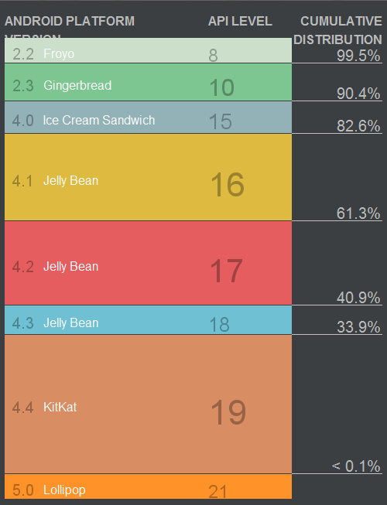
Espresso
Pros:
Supports API level 8 and above
UI thread synchronisation
Use of Hamcrest matchers (custom matcher)
Cons:
Only test one application
No support for web views
Reference:
http://stackoverflow.com/questions/18271474/robolectric-vs-android-test-framework
http://testdroid.com/news/how-to-run-espresso-tests-in-testdroid-cloud
Notes:
API level >= 8
Makes user specified sleeps unnecessary - the framework will know when each UI action is executed and will execute the test commands automatically at the right time.
Makes the test scripts very simple to write and read

Slide 19
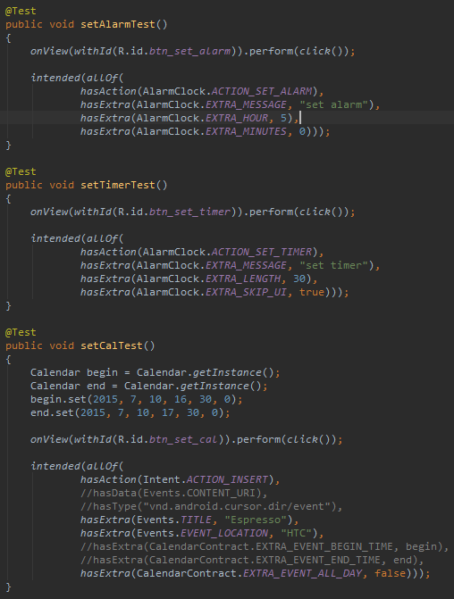
Espresso (cont.)
Source code example

Slide 20
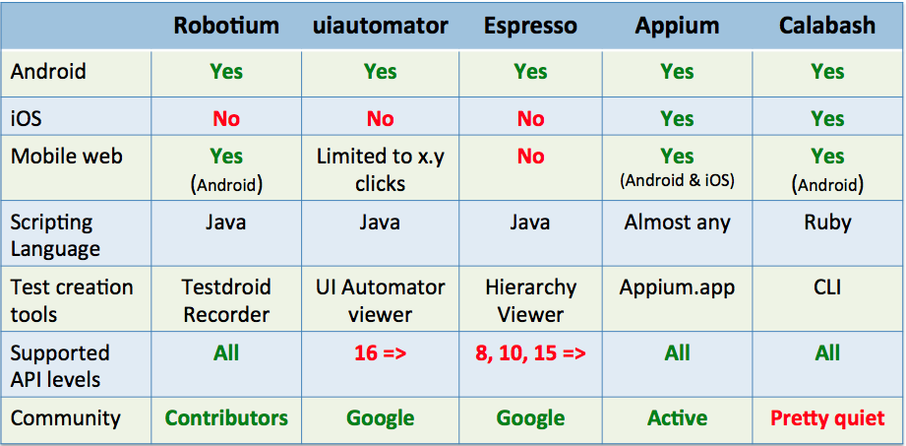
Summary
Notes:
Testdroid Recorder: Our solution lets you record actions on object level when using the app on the phone. Recording on object level enables playback of the test scripts on various Android devices despite the differences in the OS versions, UI themes, screen sizes, screen resolutions and so on.
Hierarchy viewer: only on emulator/simulator

Slide 21
Overview
Android testing framework (pros and cons)
Espresso
How to set up
How to use
Demo
Conclusion
Q&A

Slide 22
How to set up
Make sure you have installed the Android Support Repository under Extras (espresso 2.2 is available from rev 15).
Open your app/build.gradle file.
Add the following lines inside dependencies:
androidTestCompile ‘com.android.support.test:runner:0.3’
androidTestCompile ‘com.android.support.test:rules:0.3’
androidTestCompile ‘com.android.support.test.espresso:espresso-core2.2’
Add the following lines inside defaultConfig:
testInstrumentationRunner “android.support.test.runner.AndroidJUnitRunner”
Add the following lines inside android:
packagingOptions { exclude ‘LICENSE.txt’ }
Reference:
https://developer.android.com/training/testing/ui-testing/espresso-testing.html
https://code.google.com/p/android-test-kit/wiki/EspressoSetupInstructions

Slide 23
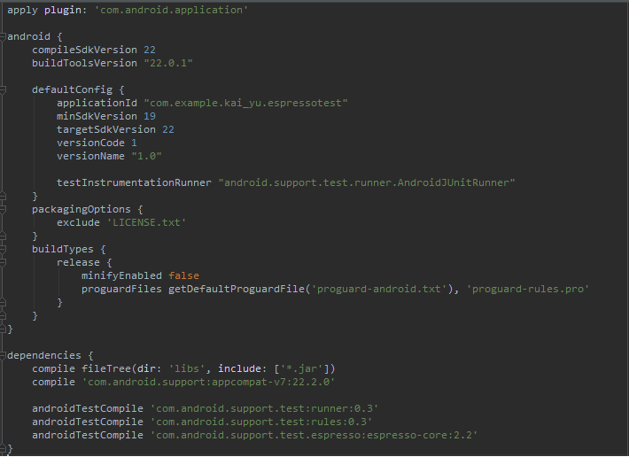
How to set up (cont.)
Example build.gradle file

Slide 24
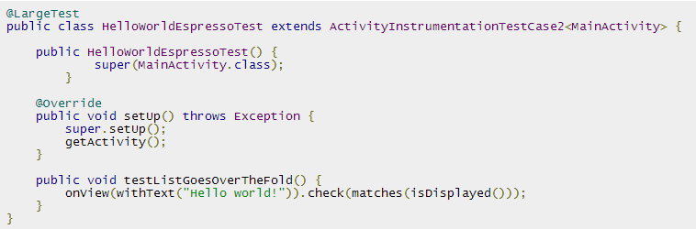
How to set up (cont.)
Turn off animations on your test device
Window animation scale
Transition animation scale
Animator duration scale
Add tests under: app/src/androidTest
Example JUnit3 test

Slide 25
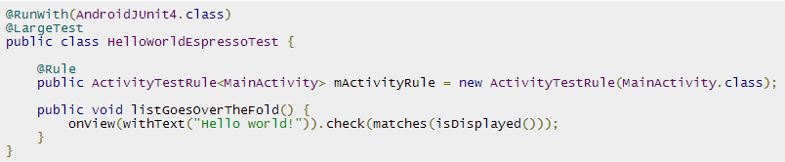
How to set up (cont.)
Add tests under: app/src/androidTest
Example JUnit4 test (prefered)

Slide 26
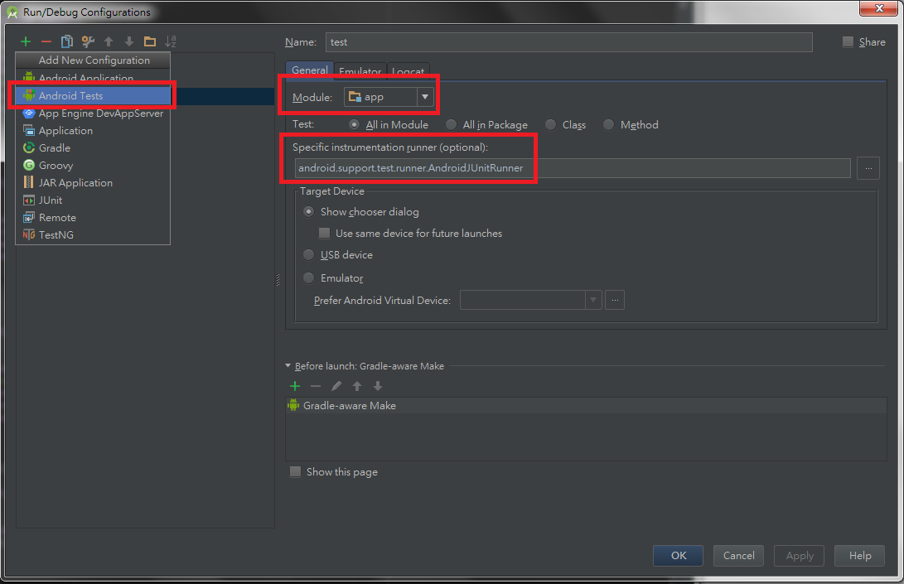
How to set up (cont.)
Create a test configuration
Open Run menu | Edit Configurations
Add a new Android Tests configuration
Choose a module
Add a specific instumentation runner:
android.support.test.runner.AndroidJUnitRunner
Run the newly created configuration
Enjoy your Espresso!

Slide 27
Overview
Android testing framework (pros and cons)
Espresso
How to set up
How to use
Demo
Conclusion
Q&A

Slide 28
How to use
Basically, there are 3 steps:
onView (Matcher<View>) - “find” something
perform (ViewAction) - ”do” something
check (ViewAssertion) - ”check” something

Slide 29
How to use (cont.)
Example:
onView(withId(R.id.my_view)).perform(click()).check(matches(isDisplayed()));
onView(withId(R.id.hello_world_text)).check(matches(withText(“Hello world!”)));
intended(allOf(hasAction(AlarmClock.ACTION_SET_ALARM),
hasExtra(AlarmClock.EXTRA_MESSAGE, “set alarm”),
haxExtra(AlarmClock.EXTRA_HOUR, 5),
hasExtra(AlarmClock.EXTRA_MINUTES, 0)));
onView(withId(R.id.editTextUserInput))
.perform(typeText(STRING_TO_BE_TYPED), closeSoftKeyboard());
onView(withText(“South China Sea”))
.inRoot(withDecorView(not(is(mActitivity.getWindow().getDecorView()))))
.check(matches(isDisplayed()));
Reference:
https://github.com/googlesamples/android-testing

Slide 30
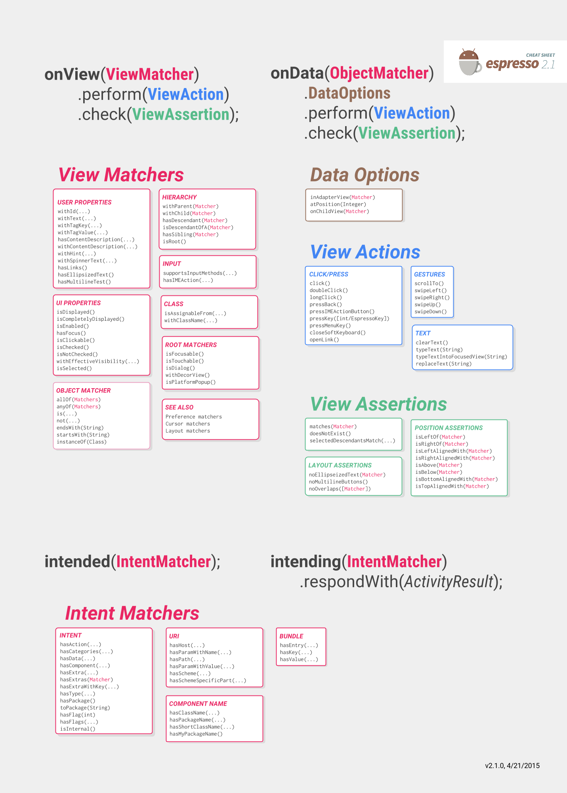
How to use (cont.)
Espresso cheat sheet 2.1

Slide 31
Overview
Android testing framework (pros and cons)
Espresso
How to set up
How to use
Demo
Conclusion
Q&A

Slide 32
Demo

Slide 33
Overview
Android testing framework (pros and cons)
Espresso
How to set up
How to use
Demo
Conclusion
Q&A

Slide 34
Conclusion
Espresso is …
Easy
Concise
Reliable
Fast
Durable
Flexible
Notes:
Easy: concise code, learning curve is low
Concise:find, do, check
Reliable: know UI thread status
Fast: no more waits
Durable: already pretty good in instrumentation, you don’t need to re-write your test scripts after you modified your app. resource ID vs description string
Flexible: custom matcher due to using Hamcrest

Slide 35
Conclusion (cont.)
Espresso is NOT…
for multiple applications test
for non-technical person

Slide 36
Overview
Android testing framework (pros and cons)
Espresso
How to set up
How to use
Demo
Conclusion
Q&A

Slide 37
Q&A

Slide 38
Contact
If you’re still confused, feel free to ask me via:
Email: kai_yu@htc.com
Skype: rebellionyu
Come to me directly

Slide 39
Thank you for your listening!

Slide 40
Appendix
Here are some useful websites:
Espresso Official Website:
https://code.google.com/p/android-test-kit/
Espresso Official Online Forum:
https://groups.google.com/forum/#!forum/android-test-kit-discuss
Espresso Sample Code:
https://github.com/googlesamples/android-testing
https://github.com/vgrec/EspressoExamples
Introduction to Espresso:
https://androidresearch.wordpress.com/2015/04/04/an-introduction-to-espresso/
GTAC 2013: Espresso: Fresh Start to Android UI Testing (video)
https://www.youtube.com/watch?v=T7ugmCuNxDU&list=SPSIUOFhnxEiCODb8XQB-RUQ0RGNZ2yW7d
GTAC 2013: Espresso: Fresh Start to Android UI Testing (slides)
https://docs.google.com/presentation/d/18bSVCKn_mInjJEWPaeVpTkwimlmc7HkaVZHntllUxek/pub?start=false&loop=false&delayms=3000&slide=id.gd2ffe53a_038

Slide 41
Appendix (cont.)
Here is my sample code:
EspressoTest
https://drive.google.com/file/d/0Byx_dkTJfcJ2WEhDVWlUV2lFa2s/view?usp=sharing
EspressoTest2
https://drive.google.com/file/d/0Byx_dkTJfcJ2dEF1TERrRU45S0U/view?usp=sharing
EspressoTest3
https://drive.google.com/file/d/0Byx_dkTJfcJ2XzJHUENHZ2RucjQ/view?usp=sharing

